Slide 1
Raag detection using HMM
Dhruva Kumar

Slide 2
What is a Raag?
A raag is a musical concept in Indian classical music.
Technically, each raag is defined by a certain set of predetermined melodic notes and flavored by how these notes transition from one to another.
The most emphasized note is called the vadi and the second most emphasized note is the samvadi
Each raag is scientifically proven to express certain emotions which is characteristic of the raag

Slide 3
Why do I care?
Identification of a raag is important to people in the Indian musical domain for composition, practice, etc.
It takes a trained musician with 10 - 15 years of experience to be able to identify a raag
Musical therapy: By recognizing which song a person likes to listen and thus the raag, similar songs based on that raag and mood can be played back.

Slide 4
Some elements of a raag
Characteristic sequences for every raag:
aaroh (ascending transition of melodic notes in a scale)
avroh (descending transition)
pakad (ascending and descending transition capturing the uniqueness of the raag in a succinct manner)
Most emphasized note: vadi
Second most emphasized note: samvadi
HMM can be used to learn these characteristic transitional probabilities between melodic notes for each raag!

Slide 5
Algorithm flow
Dataset: GTraagDB
Feature extraction (Pitch contour)
Feature quantization
Learn the model {pi, A, B} using Baum Welch
Test using forward-backward procedure

Slide 6
Dataset: GTraagDB
http://prernagupta.com/parag/data/GTraagDB/
Consists of 31 raags recorded by various musicians, assembled by Parag Chordia
Includes vocal and instrumental recordings
Training set: 5 raag classes
Bihag
Darbari
Desh
Gaud Malhar
Yaman
Each class has 3 recordings of sarod and sitar .
Test set: 16 sample recordings of vocals and sitar.

Slide 7
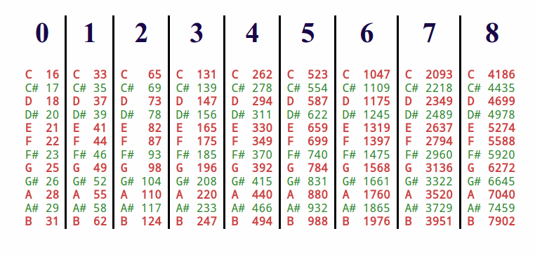
Feature extraction and quantization
Extract pitch contour using Praat
Praat uses an enhanced autocorrelation function for pitch detection
The estimated pitch frequencies are then quantized to the nearest chromatic scale pitch
Frequency to pitch mapping:
where n = nth key on a 88 key piano
Considered only three octaves
Mandra (C3-B3), madhya (C4-B4),
taar saptak (C5-B5)
Pitch shifted to tonic frequency pitch
(C4 = 262 Hz)

Slide 8
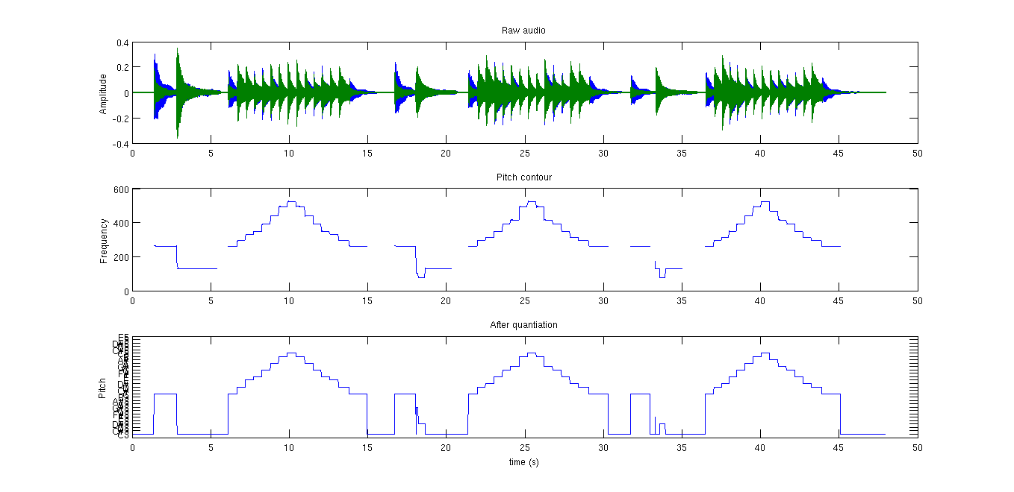
Pitch detection using Praat (enhanced ACF)

Slide 9
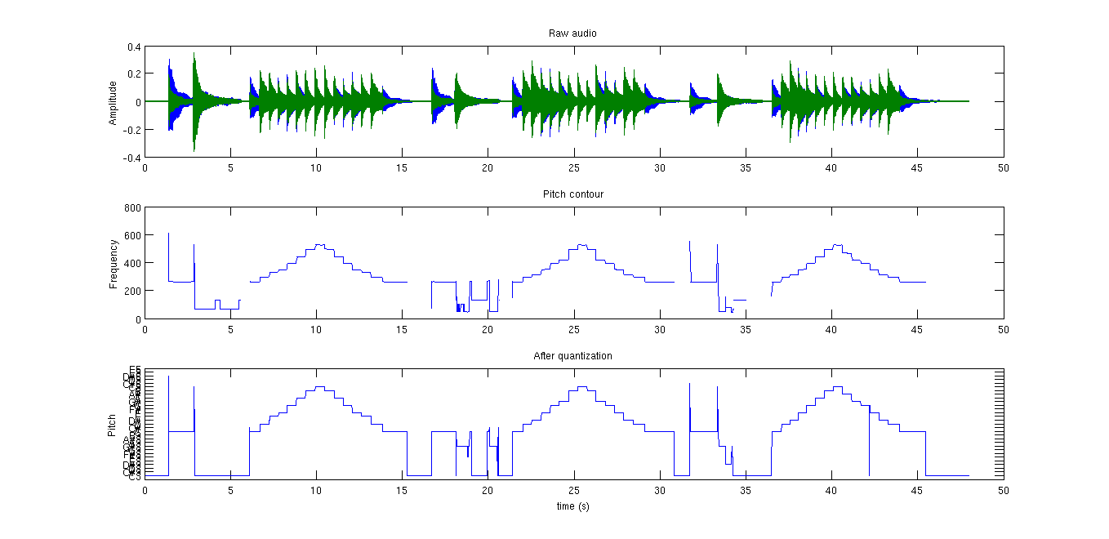
Pitch detection using Aubio (Yin)

Slide 10
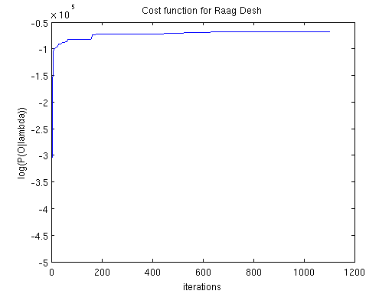
Learning: Baum Welch
Initial model: randomized, fully connected HMM structure
N = 36, M = 36
Convergence criteria: difference between
the log likelihood of P(O | λ) between two iterations < 0.1
Testing was done with forward-backward
procedure

Slide 11
Results
Test set contained vocal and instrumental recordings
Accuracy: 81.25% (13/16)
Vocal: 2/4
Instrumental: 11/12
100% accuracy if considering the 2nd and 3rd highest log likelihood
Raag desh was misclassified twice since it shares the same melodic notes as Raag gaud malhar
Predicted → Actual ↓ | Bihag | Darbari | Desh | Gaud Malhar | Yaman
Bihag | 2 | 0 | 0 | 0 | 0
Darbari | 0 | 3 | 0 | 1 | 0
Desh | 0 | 0 | 1 | 2 | 0
Gaud Malhar | 0 | 0 | 0 | 4 | 0
Yaman | 0 | 0 | 0 | 0 | 3

Slide 12
Future work
Enhance the training set in terms of quality and quantity over a range of modalities
Incorporate characteristics sequences of a raag aaroh, avroh, pakad and increase its weights
Better pitch detection algorithm?
Remove sympathetic string tones so that HMM can learn the transition probabilities between the notes specific to each raag better.
Incorporate more features like the amplitude since some notes in raags are more pronounced than the other notes (vadi).

Slide 13
Thank you!

